Slide 1
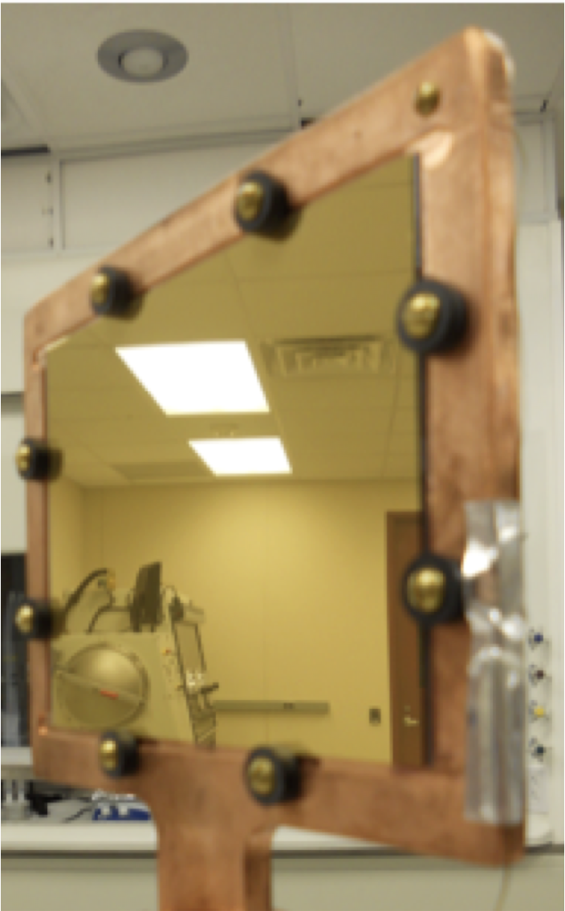
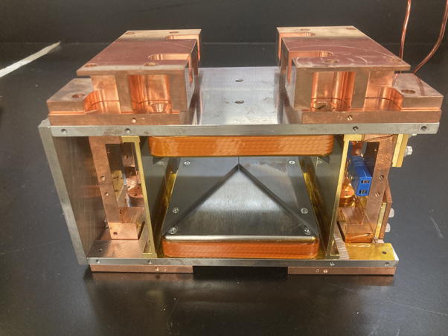
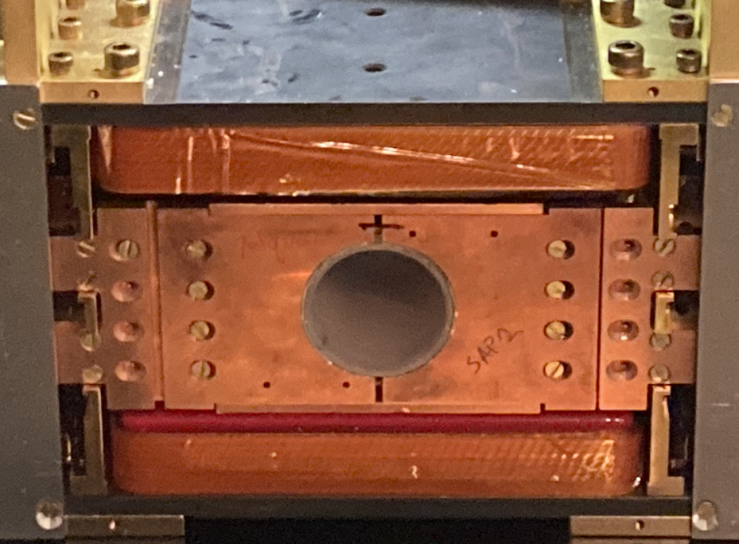
Steve Kuhn bio
Now working in Lowell’s Neutron Optics & Polarization Group
Previous:
Indiana University Postdoc with Roger Pynn
Using superconducting films for sharp magnetic field boundaries for fields perpendicular to the beam direction
Developing polarization instrumentation like RF flippers, NRSE correction coils, Wollaston prisms
Worked at ORNL as a grad student with Lisa Debeer-Schmitt
YBCO film
NRSE Correction Coil
RF Flipper

