Slide 1
Model Based Iris Recognition with Plenoptic Cameras
Technology Opportunity
Available for Licensing
Principal Investigators:
Hector J. Santos-Villalobos
hsantos@ornl.gov
Commercialization Manager:
Eugene Cochran
cochraner@ornl.gov

Slide 2
Iris Recognition
An automated method of biometric identification;
Uses mathematical pattern-recognition techniques on video images of one or both of the irises of an individual's eyes;
An iris exhibits complex random patterns that are unique, stable, and can be seen from some distance;
The key advantage of iris recognition, besides its speed of matching and its extreme resistance to false matches, is the stability of the iris as an internal and protected, yet externally visible organ of the eye;
Research on many aspects of iris recognition technology and on alternative methods has exploded, and today there is a rapidly growing academic literature on optics, photonics, sensors, biology, genetics, ergonomics, interfaces, decision theory, coding, compression, protocol, security, mathematical and hardware aspects of this technology.
Iris is one of three biometric identification technologies internationally standardized by ICAO for use in future passports (the other two are fingerprint and face recognition).

Slide 3
Technology Leadership
ORNL off-angle iris recognition
  Unconstrained image acquisition
  Plug-and-play with existing enterprise level software
  Limbus Effect
Plenoptics
  Non-mechanical refocusing
  3D information in a single shot
  Greater depth of field
  Low cost sensor
  Small form factor
Performance indicators
  Increase in image quality,
  matching score, and
  ease of use
ORNL Off-Angle Iris vs. Neurotechnology VeriEye

Slide 4
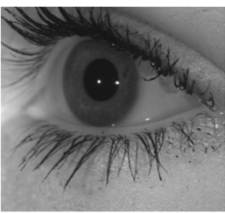
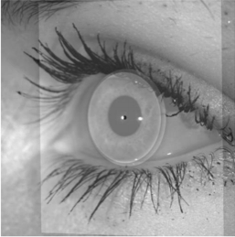
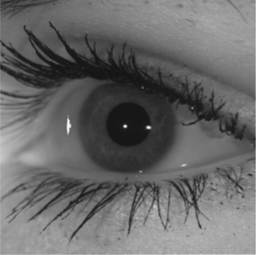
Technology Opportunity
Current stage of technology
  Off-Angle Iris to Frontal (TRL 5):
    Algorithm implemented and tested
    Several peer-reviewed publications on the technique
  Plenoptic Camera (TRL 4)
    In-house fabrication of MLA
    Reconstruction algorithm implemented
    Depth estimation implemented
What is the next step?
  Integration of technologies
    Light Field + ORNL off-angle iris recognition
  Demonstration to industry partners
  Greater than 50° Off Axis
Original
Model-Fit
Result

Slide 5
Commercialization Plan
Integrate and validate technology by continuing laboratory testing and perfecting our product
Partner with the big biometric developers in order to identify most compelling applications
Demonstrate technology and continue research effort under WFO or CRADA funded projects
Continue development of IP

Slide 6
Applications-Target Customers-Current Practice
 | Application Description | Target Customers | Current Practice
Bank Accounts | Secure Access to Sensitive and Valuable Assets | Banks, Hedge Fund Managers, FCU | IDs, Fingers
Access Control | Protect access to nuclear sites, military bases, businesses, facilities, houses, etc. | Government, Military, Industry, Individual | Badges, IDs, Finger, Iris (Very Limited)
E-Services | Access to web services such as internet shopping, IRS, e-government, etc. | Industry, Commerce, Gov. | IDs, Finger, Near-Field Communication (Apple-Pay)
Personal Computers | Login to personal computers | Industry, Individuals, Gov. | Password, Badges, Face, Finger
Marketing and Client Profiling | Identify and track clients’ consumption patterns | Retail Businesses | Face, Cellphone Signal, Loyalty Programs

Slide 7


Competitive Differentiation
Technology Feature | ORNL Technology | Neuro-Technology | 3M Cogent | Bioenable | Crossmatch | Iris ID | Safran
Low Cost/ Operational Flexibility
Highly Accurate Focus/ Wide Range
3D Information on Depth Using Off-Angle Imaging
Compatibility/ Cross Compatibility with Existing Systems
Pre-Correction of Images Prior to Recognition (Limbus Effect)

Slide 8

Intellectual Property
ORNL 2863 - US Patent Application Serial No.: 13/910,069 filed on 06/04/2013; Issued as US No.: 8,958,608 - Biometric Eye Model and Ray Tracing for Improved Iris Recognition.
ORNL 3128 – US Patent Application Serial No.:: 14/710,427 filed on 05/12/2015; Iris Recognition via Plenoptic Imaging

Slide 9
Contact Information
For technical information:
Hector J. Santos-Villalobos
hsantos@ornl.gov
For licensing information:
Eugene Cochran
cochraner@ornl.gov

